Slide 1
Data Preprocessing ——Data Reduction——
徐华
清华大学 计算机系 智能技术与系统国家重点实验室
xuhua@tsinghua.edu.cn

Slide 2
Data Preprocessing
About data
Why preprocess the data?
Descriptive data summarization
Data cleaning
Data integration and transformation
Data reduction
Discretization and concept hierarchy generation
Summary

Slide 3
Data Reduction Strategy
A data warehouse may store terabytes of data
Complex data analysis/mining may take a very long time to run on the complete data set
Data reduction
Obtain a reduced representation of the data set that is much smaller in volume but yet produce the same (or almost the same) analytical results
Data reduction strategies
Data cube aggregation（refer to chapter 4）
Dimensionality reduction—remove unimportant attributes
Data Compression—wavelet transform
Numerosity reduction—fit data into models
Discretization and concept hierarchy generation

Slide 4
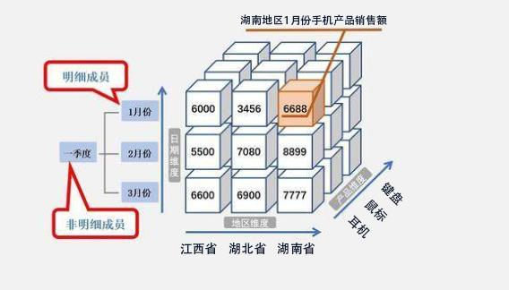
Data Cube Aggregation
The lowest level of a data cube (base cuboid)
The aggregated data for an individual entity of interest
E.g., a 3C selling data warehouse
Multiple levels of aggregation in data cubes
Further reduce the size of data to deal with
Reference appropriate levels
Use the smallest representation which is enough to solve the task
Queries regarding aggregated information should be answered using data cube, when possible

Slide 5
Dimensionality Reduction
Feature selection（特征选择）
Select a minimum set of features such that the probability distribution of different classes given the values for those features is as close as possible to the original distribution given the values of all features
reduce # of patterns in the patterns, easier to understand
Heuristic methods （启发式方法）
step-wise forward selection
step-wise backward elimination
combining forward selection and backward elimination
decision-tree induction

Slide 6
Heuristic Feature Selection Methods
There are 2^{d} possible sub-features of d features
Several heuristic feature selection methods:
Best single features under the feature independence assumption: choose by significance tests
Best step-wise feature selection:
The best single-feature is picked first
Then next best feature condition to the first, ...
Step-wise feature elimination:
Repeatedly eliminate the worst feature
Best combined feature selection and elimination

Slide 7
Example of Decision Tree Induction
Initial attribute set:
{A1, A2, A3, A4, A5, A6}
→ Reduced attribute set: {A1, A4, A6}
A4 ?
Select significant features!
A1?
A6?
Class 1
Class 2
Class 1
Class 2

Slide 8
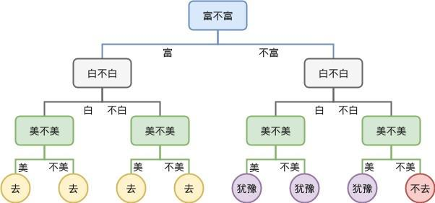
Example of Decision Tree Induction
Example

Slide 9
Data Compression
String compression
There are extensive theories and well-tuned algorithms
Typically lossless（无损的）
But only limited manipulation is possible without expansion
Audio/video compression
Typically lossy（有损的）compression, with progressive refinement
Sometimes small fragments of signal can be reconstructed without reconstructing the whole
Original Data
lossless
Compressed
Data
Original Data
Approximated
lossy

Slide 10
Wavelet Transformation
Discrete wavelet transform (DWT)（离散小波变换）: linear signal processing, multi-resolutional analysis
Compressed approximation: store only a small fraction of the strongest of the wavelet coefficients
Similar to discrete Fourier transform (DFT), but better lossy compression, localized in space
Method:
Length, L, must be an integer power of 2 (padding with 0s, when necessary)
Each transform has 2 functions: smoothing, difference
Applies to pairs of data, resulting in two sets of data of length L/2
Applies two functions recursively, until reaches the desired length

Slide 11
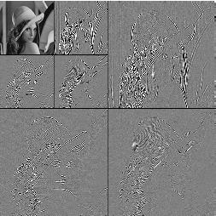
DWT for Image Compression
Image
Low Pass High
Low Pass High Pass
Low Pass High Pass

Slide 12
Principal Component Analysis
Given N data vectors from n-dimensions, find k ≤ n orthogonal vectors (principal components) that can be best used to represent data
Steps
Normalize input data: Each attribute falls within the same range
Compute k orthonormal (unit) vectors, i.e., principal components
Each input data (vector) is a linear combination of the k principal component vectors
The principal components are sorted in order of decreasing “significance” or strength
Since the components are sorted, the size of the data can be reduced by eliminating the weak components, i.e., those with low variance. (i.e., using the strongest principal components, it is possible to reconstruct a good approximation of the original data
Works for numeric data only
Used when the number of dimensions is large

Slide 13
Numerosity Reduction
Reduce data volume by choosing alternative, smaller forms of data representation
Parametric methods
Assume the data fit some model, estimate model parameters, store only the parameters, and discard the data (except possible outliers)
Example: Log-linear models（对数线性模型）—obtain value at a point in m-D space as the product on appropriate marginal subspaces
Non-parametric methods
Do not assume models
Major families: histograms, clustering, sampling

Slide 14
Data Reduction Method (1): Regression and Log-Linear Models
Linear regression: Data are modeled to fit a straight line
Often uses the least-square method（最小二乘法） to fit the line
Multiple regression: allows a response variable Y to be modeled as a linear function of multidimensional feature vector
Log-linear model: approximates discrete multidimensional probability distributions

Slide 15
Regression and Log-Linear Models
Linear regression: Y = w X + b
Two regression coefficients, w and b, specify the line and are to be estimated by using the data at hand
Using the least squares criterion to the known values of Y1, Y2, …, X1, X2, ….
Multiple regression: Y = b0 + b1 X1 + b2 X2.
Many nonlinear functions can be transformed into the above
Log-linear models（对数线性模型）:
The multi-way table of joint probabilities is approximated by a product of lower-order tables
Probability: p(a, b, c, d) = αab βacχad δbcd

Slide 16
Data Reduction Method (2): Histograms
Divide data into buckets and store average (sum) for each bucket
Partitioning rules:
Equal-width: equal bucket range
Equal-frequency (or equal-depth)
V-optimal: with the least histogram variance (weighted sum of the original values that each bucket represents)
MaxDiff: set bucket boundary between each pair for pairs have the β–1 largest differences

Slide 17
Data Reduction Method (3): Clustering
Partition data set into clusters based on similarity, and store cluster representation (e.g., centroid and diameter) only
Can be very effective if data is clustered but not if data is “smeared”
Can have hierarchical clustering and be stored in multi-dimensional index tree structures
There are many choices of clustering definitions and clustering algorithms
Cluster analysis will be studied in depth in the latter Chapter.

Slide 18
Data Reduction Method (4): Sampling
Allow a mining algorithm to run in complexity that is potentially sub-linear to the size of the data
Choose a representative subset of the data
Simple random sampling may have very poor performance in the presence of skew
SRSWOR, SRSWR, Cluster sampling
Simple random sampling without replacement (SRSWOR)
Develop adaptive sampling methods
Stratified sampling（分层采样）:
Approximate the percentage of each class (or subpopulation of interest) in the overall database
Used in conjunction with skewed data

Slide 19
Sampling
SRSWOR
(simple random
sample without
replacement)
SRSWR
Raw Data

Slide 20
Thanks！
Notes:
工作新意图发现

